Slide 1

Epsilon Greedy
Presented by:
Elizer Ponio Jr.

Slide 2
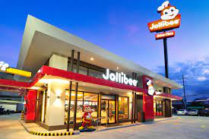
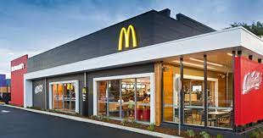
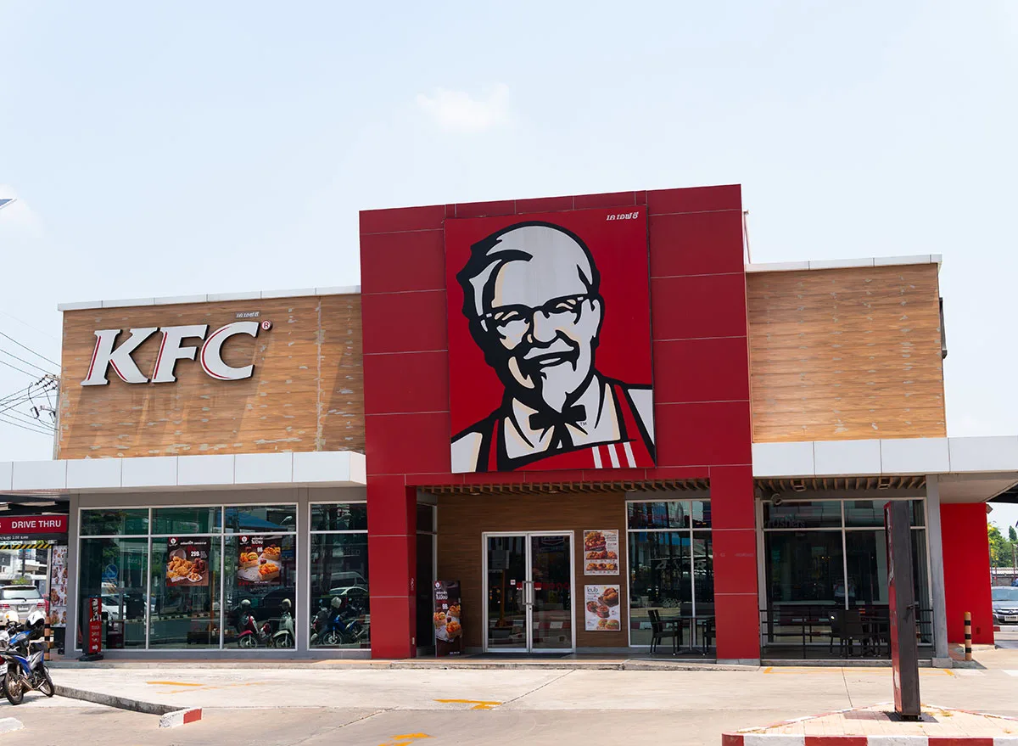

You

Slide 3
You are given 300 days and your task is to find out which restaurant has the
highest average happiness/satisfaction rating!

Slide 4
μ = 10
σ = 5
μ = 8
σ = 4
μ = 5
σ = 2.5
Let us assume that you do not know the average rating/happiness of each restaurant

Slide 5
In only ε-greedy approach, set any epsilon (ε) value from 1% to 10%
If ε = 10%, then on any given day there is a 10% chance you will randomly pick a restaurant (explore) and a 90% chance that you will go to the restaurant which has historically have the highest happiness so far (exploit).

Slide 6



Day 100 |  |  |  | Exploit
Day 102 |  |  |  | Exploit
Day 103 |  |  |  | Explore
Day 104 |  |  |  | Exploit
Day 105 |  |  |  | Exploit
Day 106 |  |  |  | Exploit
Day 107 |  |  |  | Explore
μ = 4
μ = 6
μ = 3
μ = 4
μ = 6
μ = 3
μ = 4
μ = 6
μ = 3
μ = 4
μ = 6
μ = 3
μ = 4
μ = 6
μ = 3
μ = 4
μ = 6
μ = 3
μ = 4
μ = 6
μ = 3

